Slide 1
Repeated Measures and Mixed Designs in ANOVAs
Gemma Wallace & Neil Yetz
PSY 653 Module 5 Lab
Feb 26, 2020

Slide 2
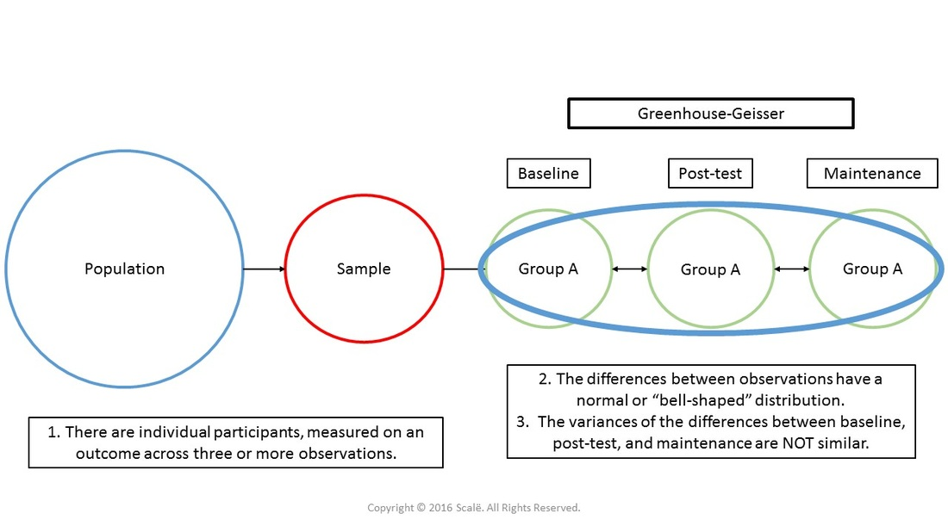
Key terms
Repeated Measures
When subjects participate in all conditions of an experiment or provide data at multiple timepoints
Sphericity
Equality of variances of the differences between treatment levels

Slide 3
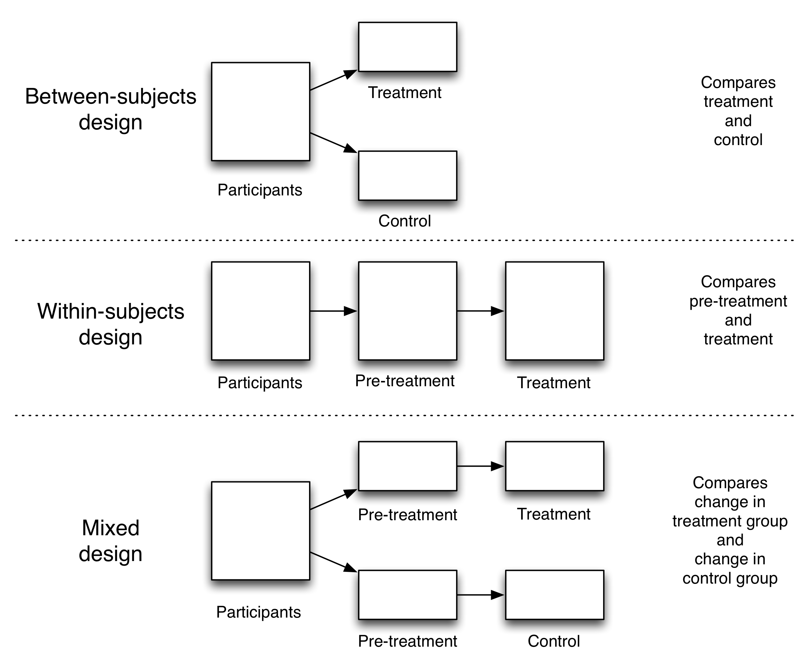

Slide 5
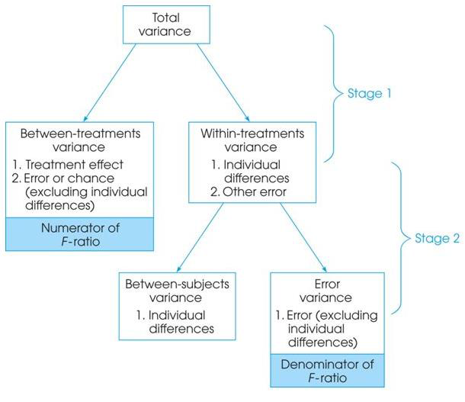
Partitioning the variance
© Alyssa Gibbons

Slide 6
Class example
A researcher is interested in the length of time it takes to say 2 syllable, 3 syllable, and 4 syllable words. She first times how long it takes each participant to say the 2 syllable word, then the 3 syllable word, then the 4 syllable word. However, half the participants are put in a condition in which there is a distracting noise in the background. She is interested if there is a difference between the control condition and the noise condition.
Source: Henderson, L., Coltheart, M., & Woodhouse, D. (1973). Failure to find a syllabic effect in number naming. Memory & Cognition, 1(3), 304-306. Retrieved from: http://users.stat.ufl.edu/~winner/data/

Slide 7
Our variables and research design
Noise Condition = between-subjects factor
Every participant is only exposed to one condition, either control or noisy
# of syllables = within-subjects factor
Every participant reads words of all three syllable lengths
Length of time to say each word = outcome variable
Mixed design
Noisy
# Syllables = 2
# Syllables = 3
# Syllables = 4
Participants
Quiet
# Syllables = 2
# Syllables = 3
# Syllables = 4

Slide 8
Start the ANOVA table and list df for each
Df numerator = (k-1)
N = 48
 | Df numerator
Noise Condition (between-subjects) | (2-1) = 1
# Syllables (within-subjects) | (3-1) = 2
Noise condition * # syllables | (2 * 1) = 2
Notes:
Df denominator for within-subjects effects= (n - 1)*(k - 1)

Slide 9
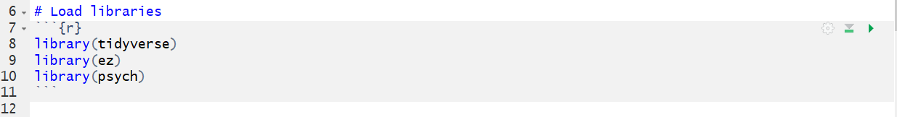
Load libraries

Slide 10
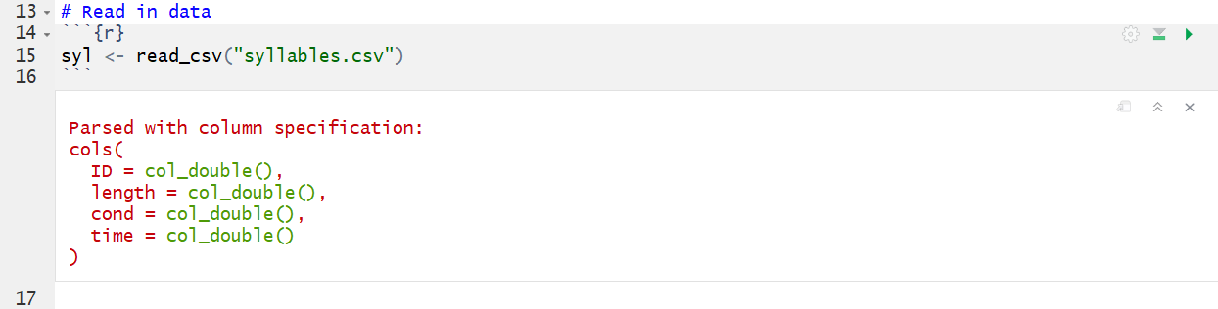
Read in the data
ID = subject id
length = # of syllables in word (2, 3, or 4)
cond = condition (0 = control, 1 = noise condition)
time = milliseconds it took to say the word (outcome variable)

Slide 11
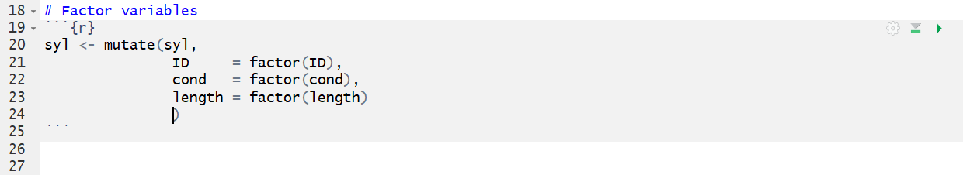
Factor the variables
*Note: ezANOVA will do this automatically, but it’s nice to remove the error message

Slide 12
The ezANOVA() Function
ModelName <- ezANOVA(data = dataframe, dv = .(outcome_variable), wid = .(variable_that_identifies_participants), within = .(repeated_measures_predictors), between = .(between_group_predictors), detailed = TRUE, type = 3)
If there are multiple predictor variables for each category, separate them with a comma e.g., .(x,y)
The period before each variable category specifies that you will list variables

Slide 13
The ezANOVA() Function
ModelName <- ezANOVA(data = dataframe, dv = .(outcome_variable), wid = .(variable_that_identifies_participants), within = .(repeated_measures_predictors), between = .(between_group_predictors), detailed = TRUE, type = 3)
We are using Type II sum of squares in these examples
The default for this function is Type II; Type III is often preferred when there is an interaction
Need to specify orthogonal contrasts
Some resources to help refresh your memory:
https://mcfromnz.wordpress.com/2011/03/02/anova-type-iiiiii-ss-explained/
“Jane Superbrain” Box 11.1 in Field, Miles, & Field (2012), pp. 475-476
Notes:
“Orthogonal contrasts are a set of contrasts in which, for any distinct pair, the sum of the cross-products of the coefficients is zero (assume sample sizes are equal).”

Slide 14
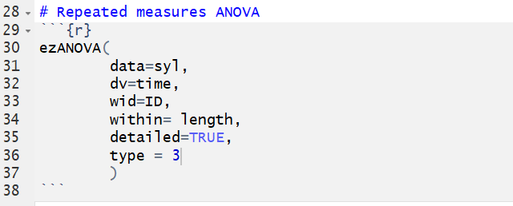
Analysis 1: Run a repeated measures ANOVA (ignoring condition for now)
Our question: Does length of time to read each word significantly differ by word syllable length?

Slide 15
data = dataset
dv = dependent variable
wid = ID grouping variable
within = within subject variable
“detailed = TRUE” indicates we want detailed output
“type = 3” indicates we would like it to perform a type 3 ANOVA

Slide 16
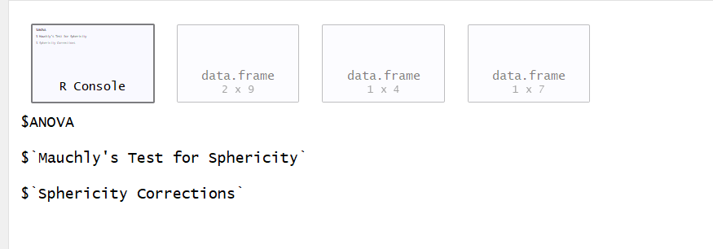
4 windows will be outputted!
R console
(Errors will be reported here)
ANOVA table
Sphericity test
Greenhouse-Geisser & Huynh-Feldt corrections

Slide 17
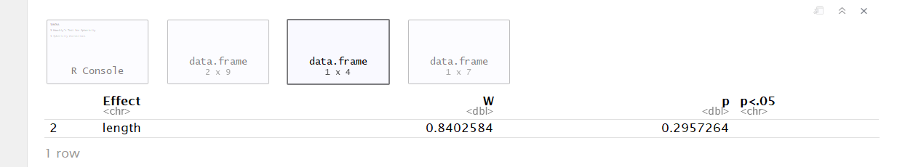
First, check if sphericity is violated
Sphericity = the variances of the differences between all possible pairs of within-subject conditions (i.e., levels of the categorical predictor) are equal
A non-significant p value (i.e., >0.05) means that the condition of sphericity has been met
Notes:
I.e., relationship between pairs of experimental conditions is similar

Slide 18
Check if sphericity is violated
Was it violated?

Slide 19
Check if sphericity is violated
ANOVA table
Was it violated?
NO!
(therefore we don’t need to deal with window 4)

Slide 20
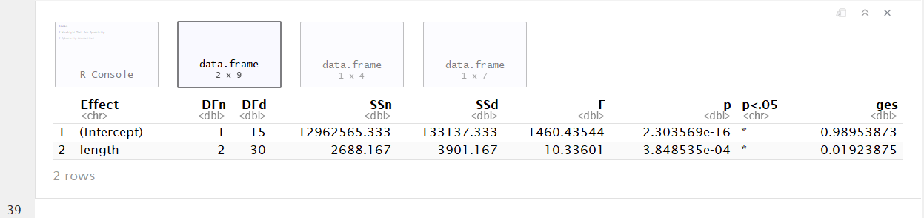
Next, view the ANOVA table (since sphericity wasn’t violated)

Slide 21
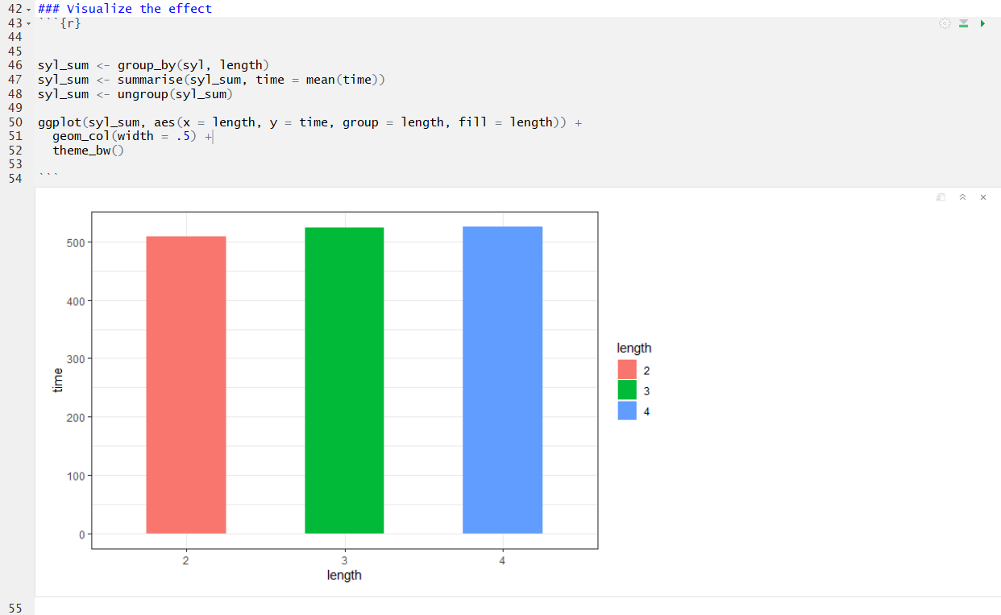
Visualize the effect of syllable length on time to read each word

Slide 22
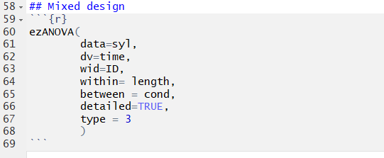
Analysis 2: Run a mixed effects ANOVA to evaluate effects of both # of syllables and noise condition on time
Our question: Does length of time to read each word significantly differ by word syllable length AND by noise condition?

Slide 23
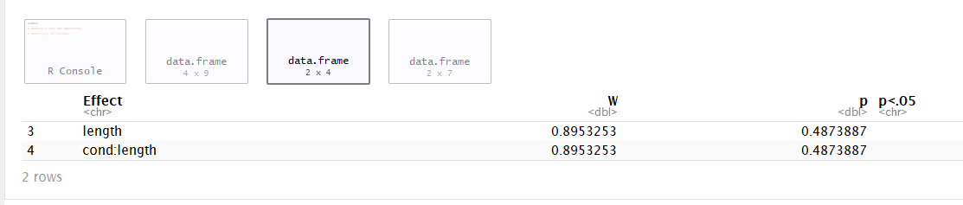
First, check if sphericity was violated

Slide 24
First, check if sphericity was violated
Was the assumption violated?

Slide 25
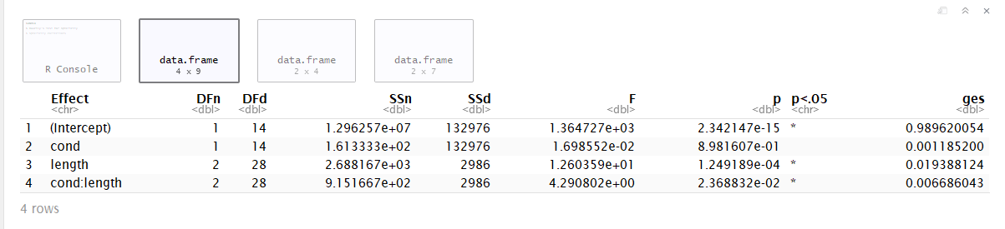
Next, view the ANOVA table (since sphericity wasn’t violated)
SSd = an error term: the amount of unexplained variance across the conditions of the within-subjects variable

Slide 26
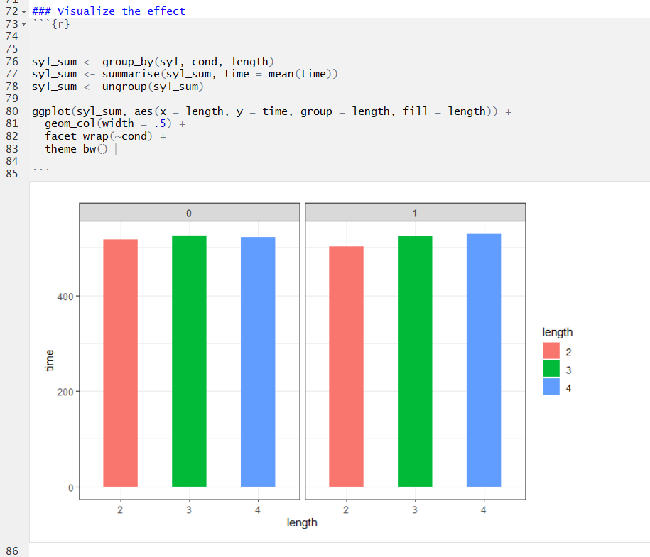
Visualize the effects of syllable length and noise condition on time to read each word

Slide 27
What should you do if the sphericity assumption is violated?
We didn’t violate the assumption in this demo activity, but if we had:
Use the output from Window 4 and apply a correction to the model F Ratio,and then use that value in your model interpretations.
(p. 554 in Field, Miles, & Field, 2012)

Slide 28
Extra Practice and Readings
Chapters 13-14 in the Field, Miles, & Field 2012 textbook describe these steps in detail
Includes instructions for planned contrasts and post-hoc analyses

